Slide 1



Cover Page
Monday, 03 Nov 2025
PROJ703/ PROJ903 International Challenge Project “Eurobot”
By
ROBO-UN
Page-01

Slide 2
TABLE OF CONTENTS
Progress Report -03
Simulation -04+05
Design -06->08
Strategies -09
Project Management -10+11
Page - 02

Slide 3
PROGRESS REPORT
What we have done:
  Simulation: Improvements to camera and crates.
  Design: Robot Case and Dribbler Design.
  Strategies: Flowchart, 2D engine.
What we have to do for next session:
  Simulation: Crates identification, gripper implementation and strategies simulation
  Design: Assemble Design Elements, and design other needed components and 3D printing.
  Strategies: Start simulating strategies on 2D engine, refine flowchart.
  Components: Finalize list and send to professors.
Page - 03

Slide 4
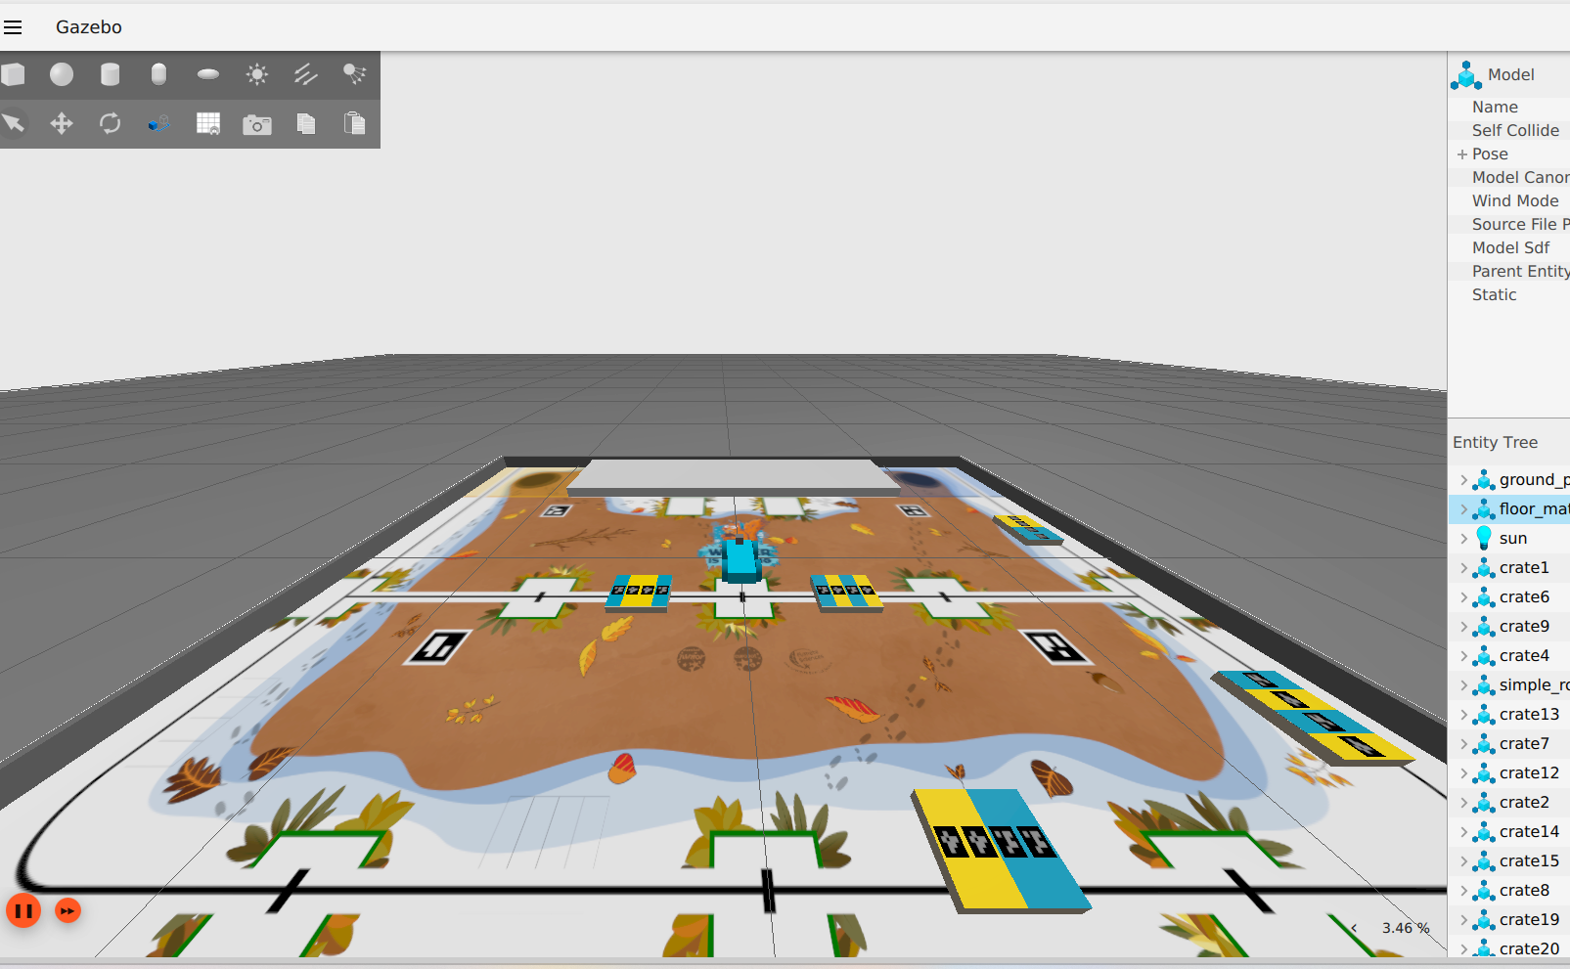
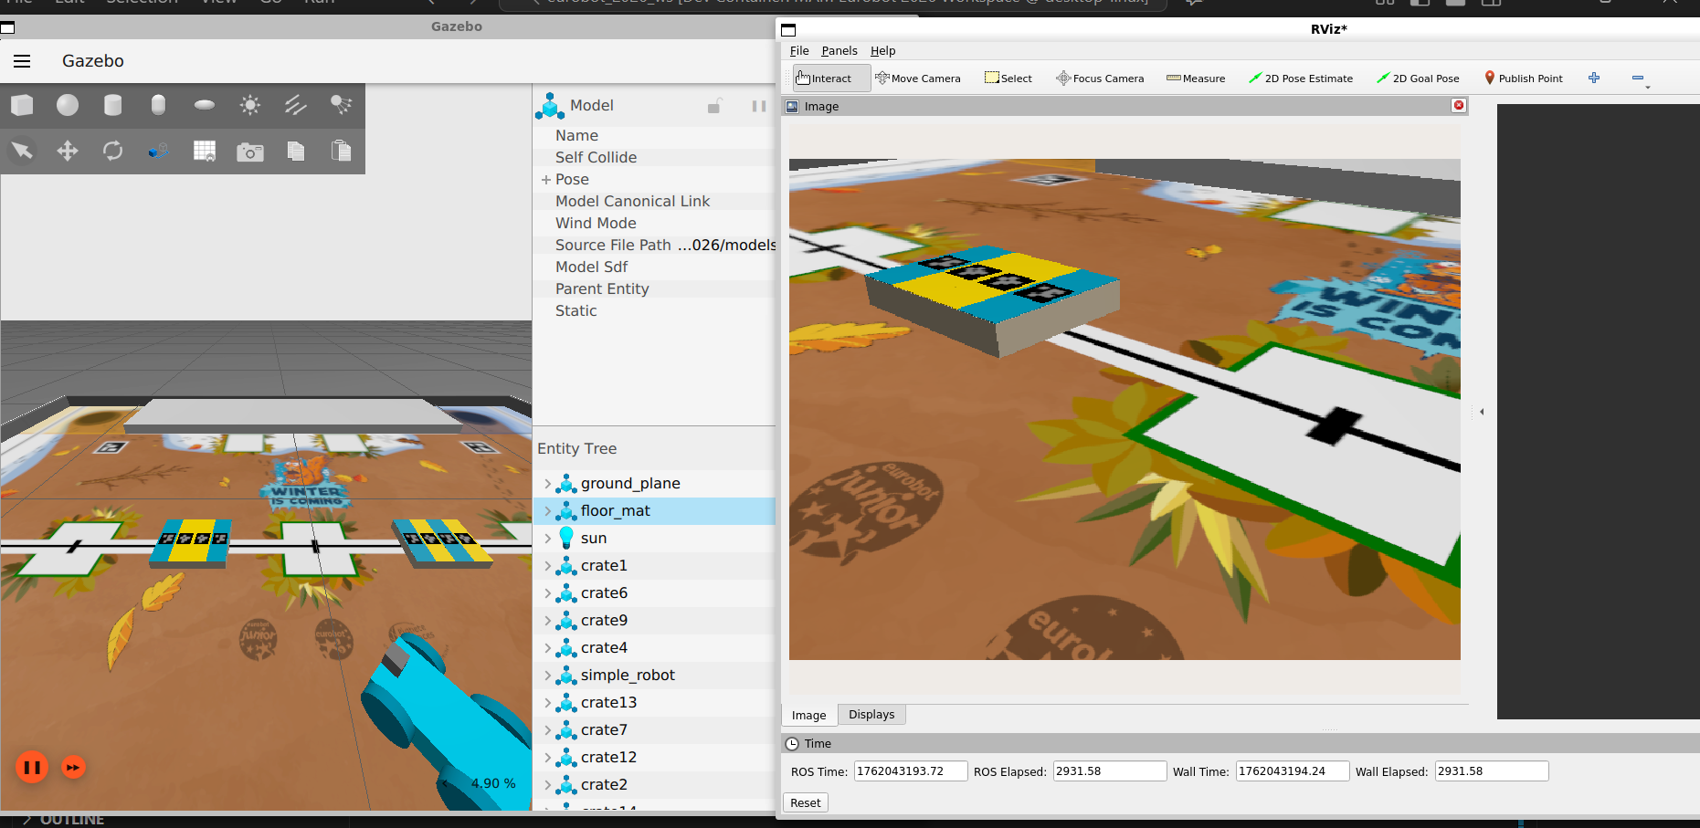
SIMULATION
Playmat updating
Page - 04

Slide 5
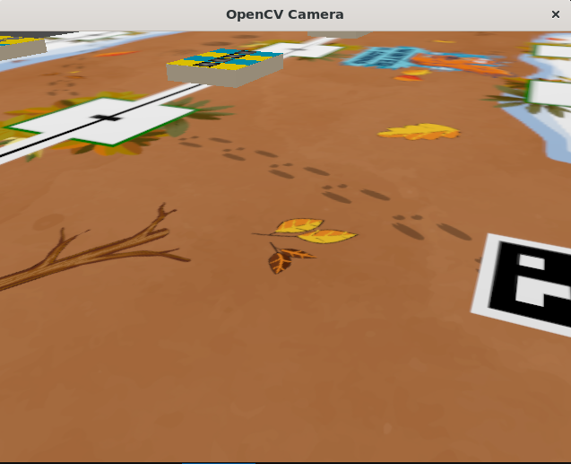
SIMULATION
OpenCV screen
Page - 05

Slide 6
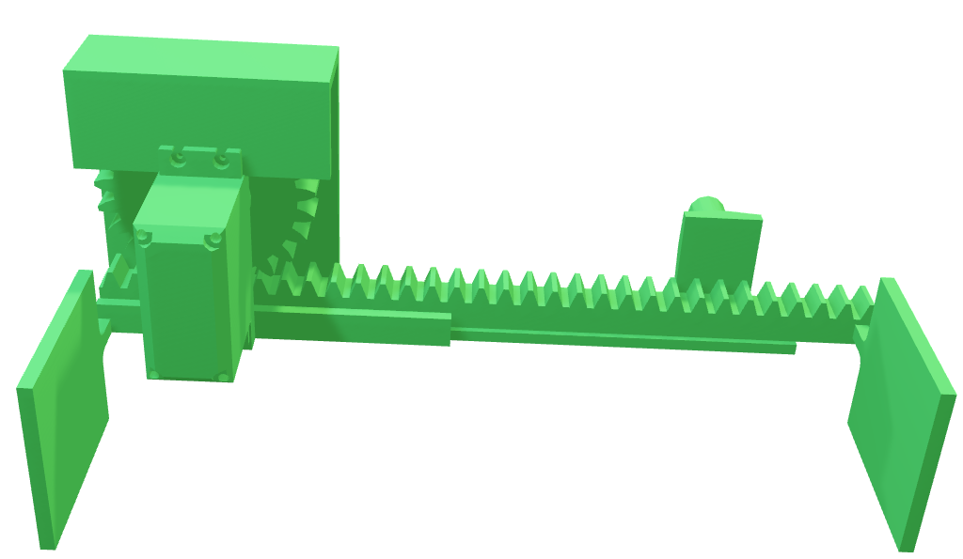
CAD Modelling – Dribbler Design
Rack and Pinon Mechanism for holding the crates:
Simple for controlling
Simple to implement
Less power load
Page - 06

Slide 7
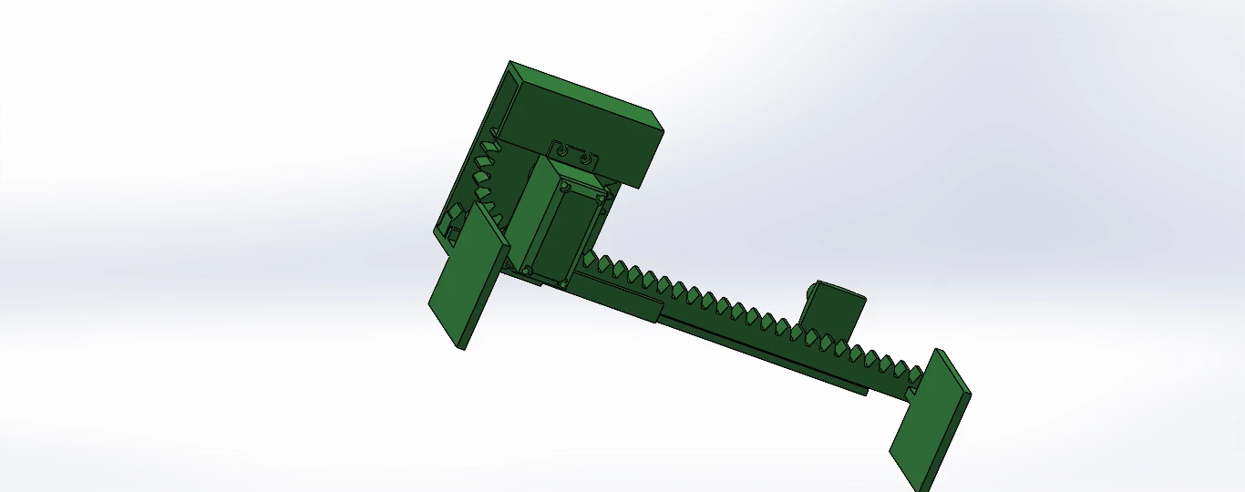
CAD Modelling- Dribbler Functioning Mechanism
Source: SolidWorks
Page - 07

Slide 8
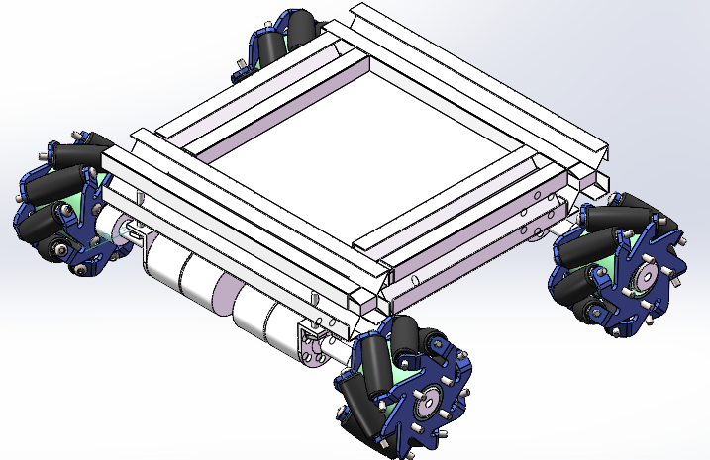
CAD Modelling- Robot Case
- Aluminum Profiles
- Wheels
- Base plate
- Guard plate
- Axle
- Motor
-Motor mount
Page - 08

Slide 9
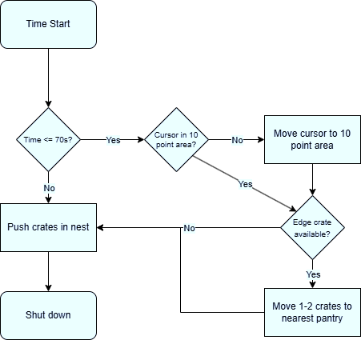
STRATEGIES
Page - 09

Slide 10
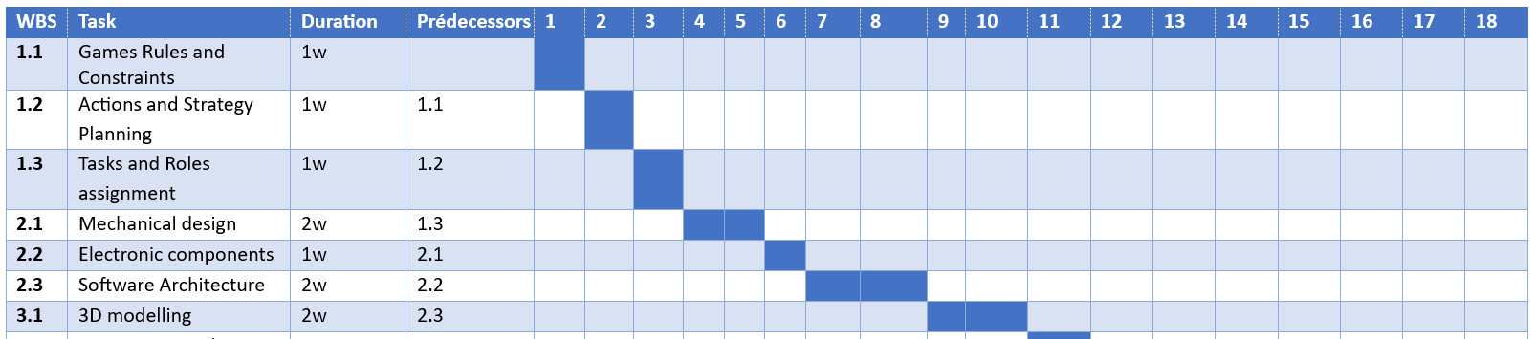
PROJECT MANAGEMENT
GANTT
Page - 10

Slide 11
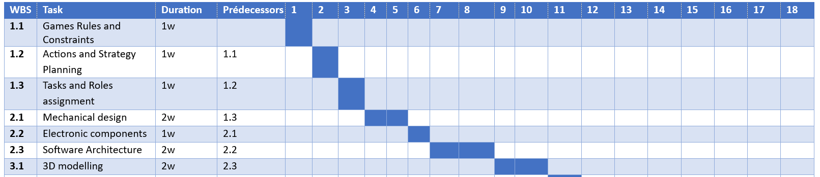
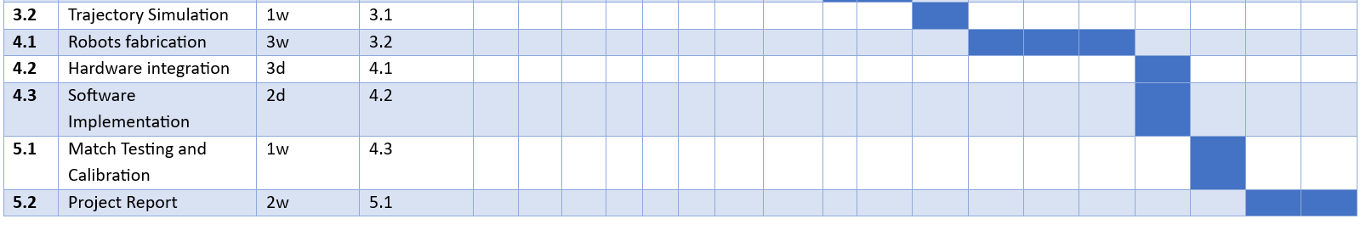
PROJECT MANAGEMENT
GANTT
Page - 11

